Slide 1



CAPSTONE PROJECT
Agentic Career Counseling Companion
Presented By : Shreyasi Datta
Student name : Shreyasi Datta
College Name : Institute of Engineering & Management
Department : Computer Science Engineering

Slide 2
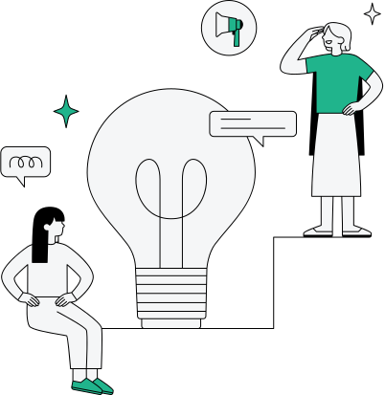
OUTLINE
Problem Statement
Technology used
Wow factor
End users
Result
Conclusion
Git-hub Link
Future scope
IBM Certifications

Slide 3

PROBLEM STATEMENT
Students often struggle to make informed career decisions due to fragmented access to guidance, limited self-awareness of academic strengths, and rapidly evolving industry landscapes. Traditional counseling methods lack personalization and scalability, leading to missed opportunities and career mismatches.
Proposed Solution
An intelligent, autonomous AI Career Counseling Agent that continuously monitors student performance, evolving interests, and real-time labor market trends to deliver tailored career pathway suggestions. This empowers students to make confident, future-ready decisions with minimal dependency on manual intervention.

Slide 4
TECHNOLOGY USED
IBM Cloud Lite Services
Natural Language Processing (NLP)
Retrieval Augmented Generation (RAG)
IBM Granite Foundation Model
Machine Learning Algorithms
Real-time Data Analytics
Conversational AI

Slide 5
IBM CLOUD SERVICES USED
IBM Cloud Watsonx AI Studio - For building and training the AI agent
IBM Cloud Watsonx AI Runtime - For deploying and running the agent
IBM Cloud Agent Lab - For agent development and testing
IBM Granite Foundation Model - Core AI capabilities for conversation and reasoning
IBM Watson Natural Language Understanding - For analyzing student responses and interests
IBM Cloud Databases - For storing student profiles and career data

Slide 6
WOW FACTORS
This agent will revolutionize career counseling by providing personalized, data-driven guidance that adapts to each student's unique profile and market conditions in real-time.
Unique Features:
Intelligent Student Profiling: Dynamic assessment of academic performance, interests, and personality traits
Real-time Market Analysis: Continuous monitoring of job market trends, salary data, and skill demands
Personalized Career Pathways: Custom-tailored career recommendations based on individual strengths and market opportunities
Skills Gap Analysis: Identifies missing skills and suggests learning resources to bridge gaps
Interactive Career Exploration: Conversational interface for exploring different career options
Progress Tracking: Monitors student development and adjusts recommendations accordingly
Industry Mentor Matching: Connects students with relevant industry professionals
Predictive Career Modeling: Uses AI to forecast career success probability in different fields

Slide 7
END USERS
High School Students - Making initial career decisions and college major selections
College Students - Exploring specializations and internship opportunities
Career Changers - Professionals seeking new career directions
Educational Institutions - Schools and colleges implementing systematic career guidance
Parents and Guardians - Supporting their children's career decision-making process
Career Counselors - Enhancing their counseling capabilities with AI insights

Slide 8
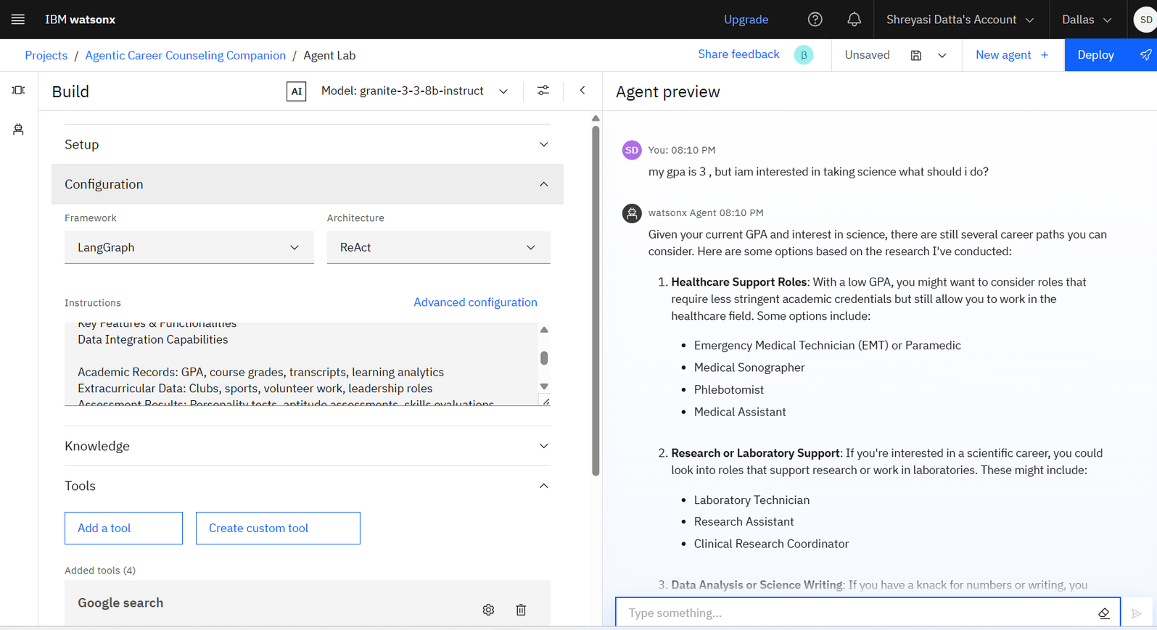
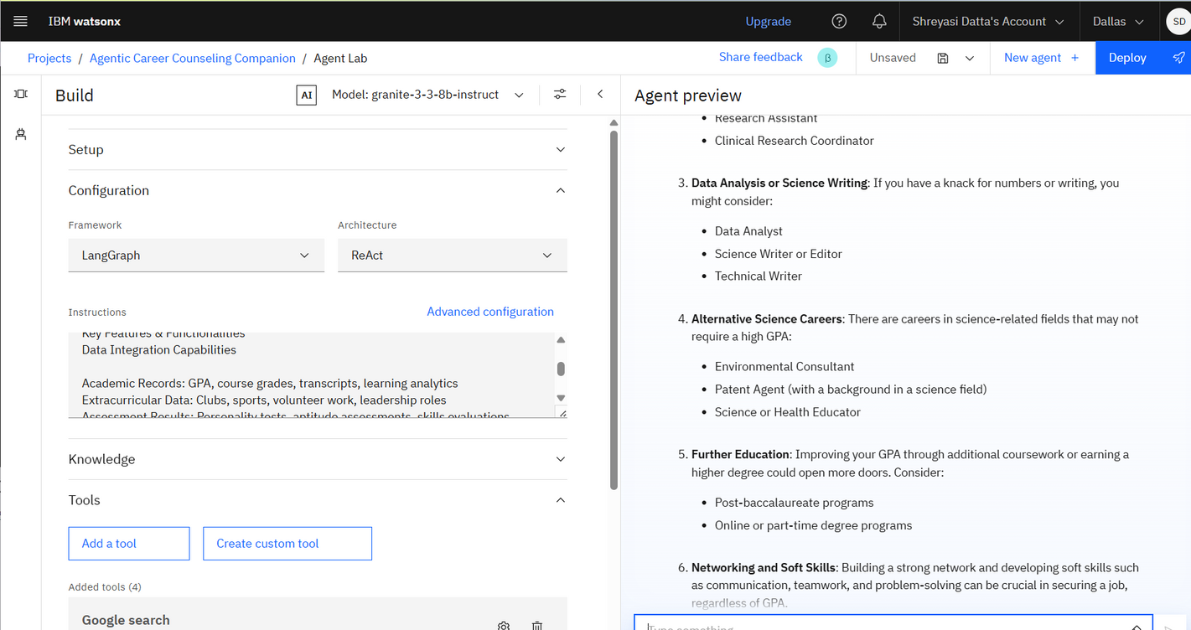
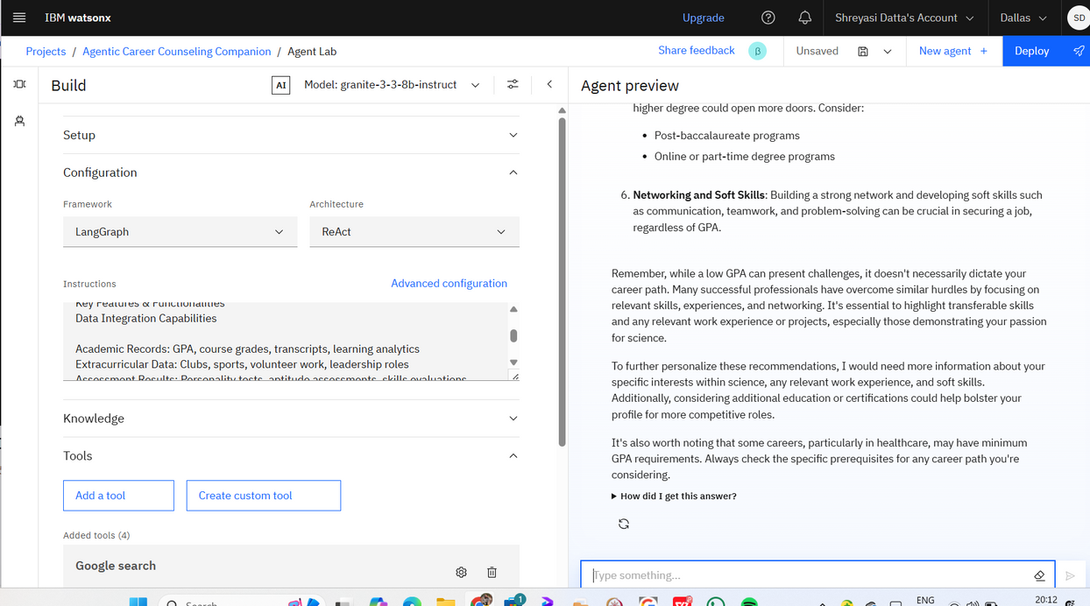
RESULTS

Slide 9
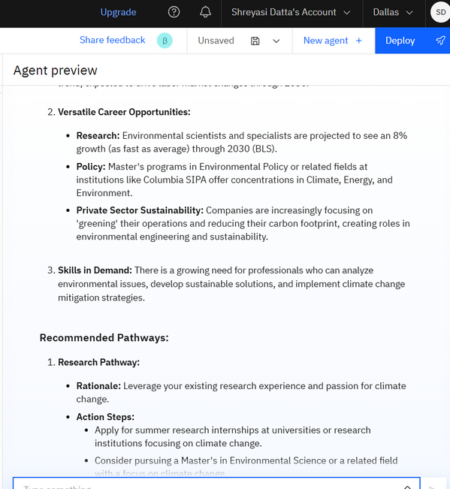
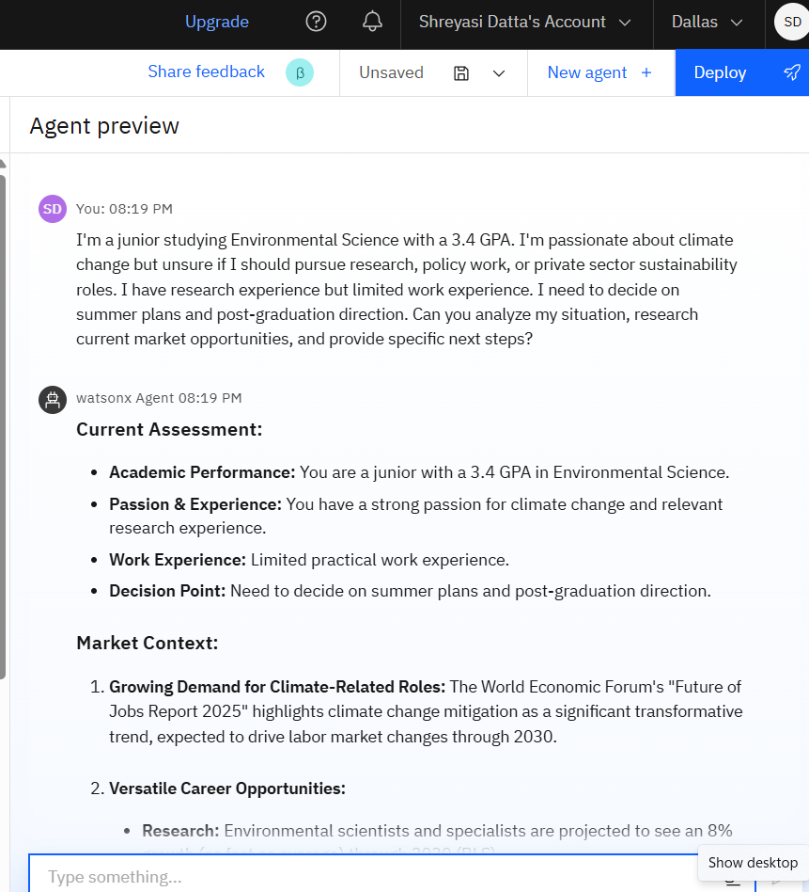
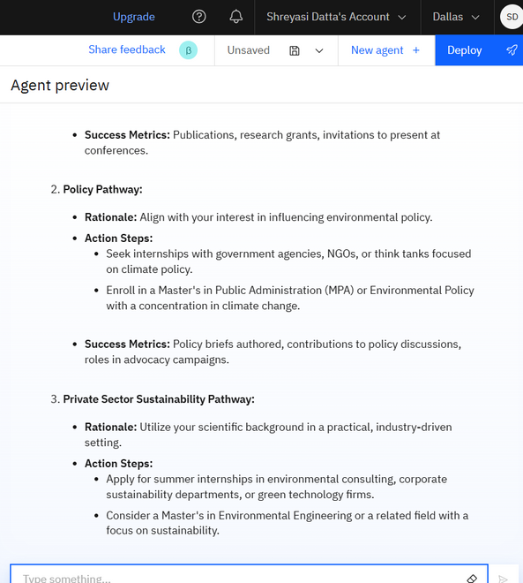
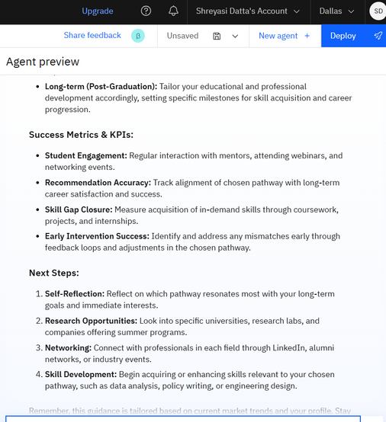
RESULTS

Slide 10
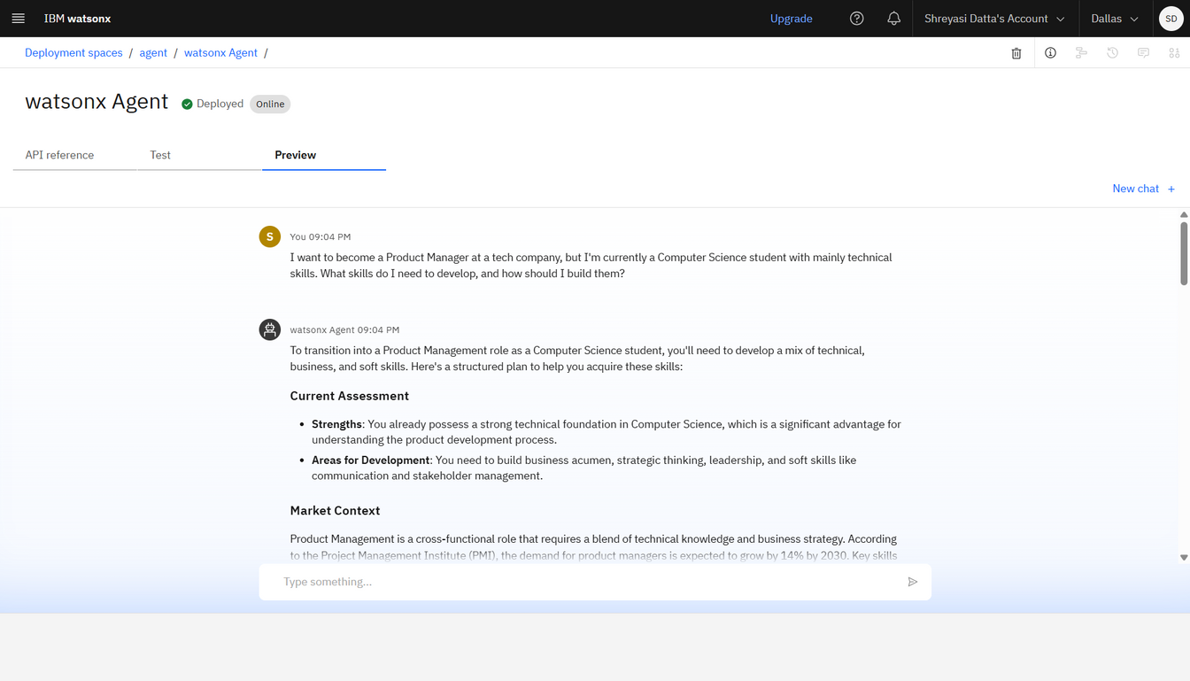
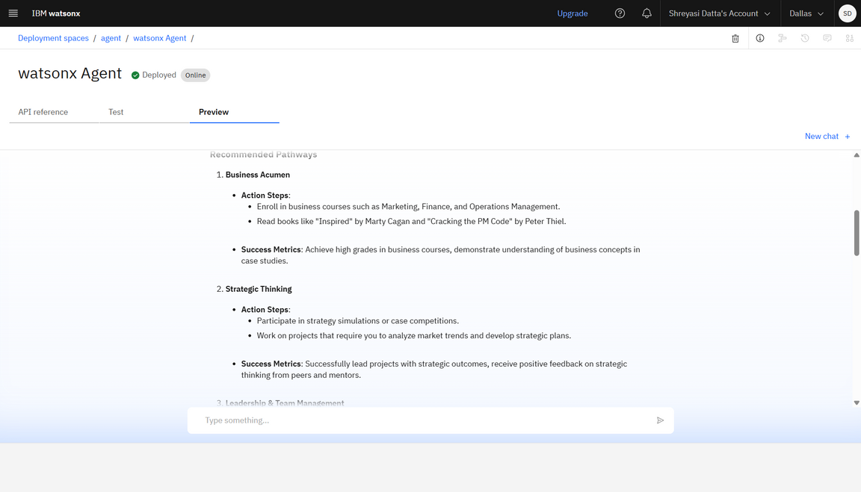
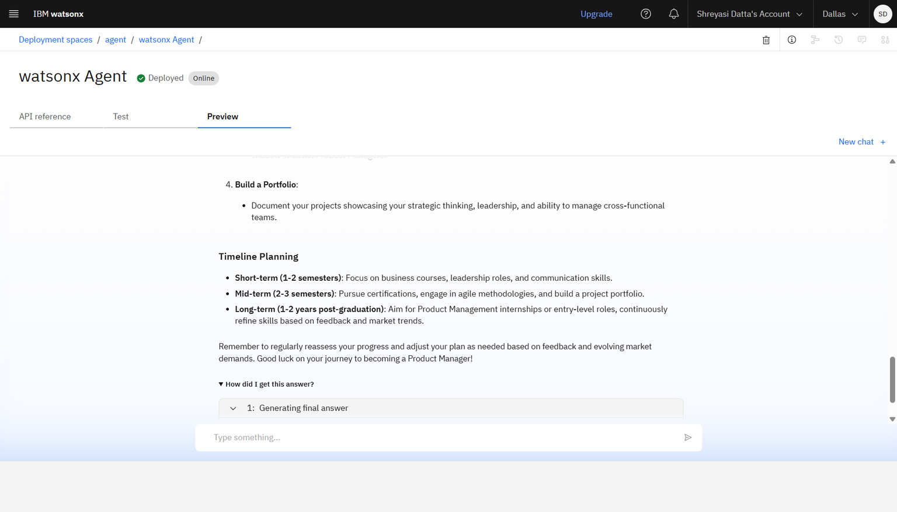
RESULTS :- Deployed AI Agent

Slide 11
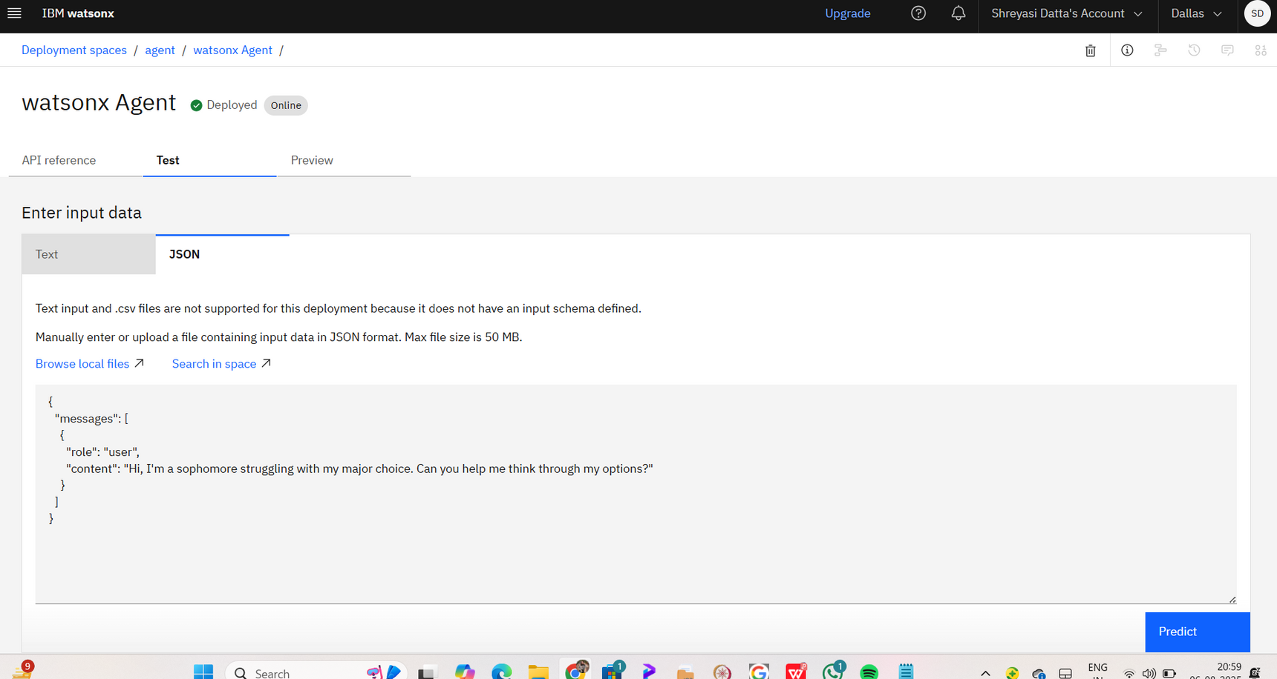
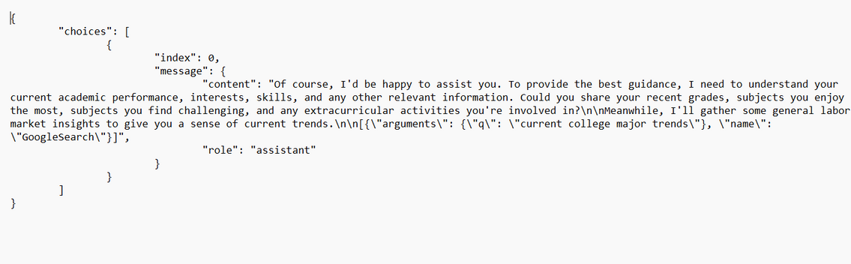
RESULTS :- Deployed AI Agent

Slide 12
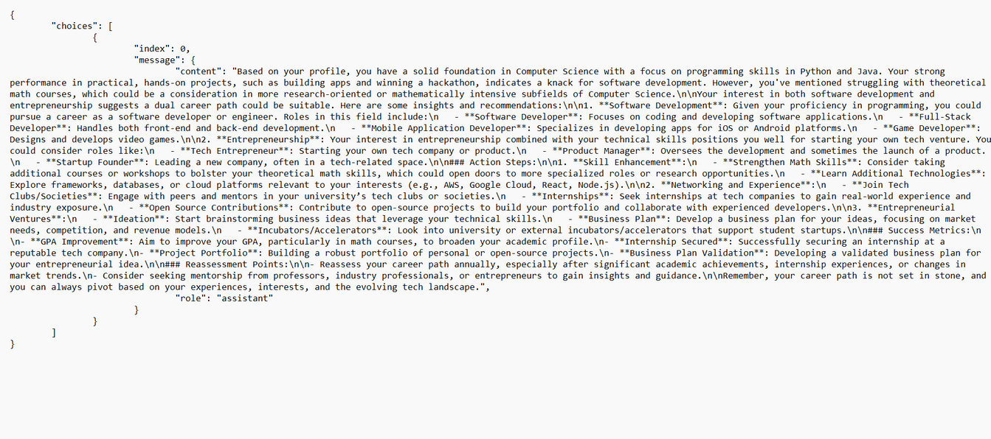
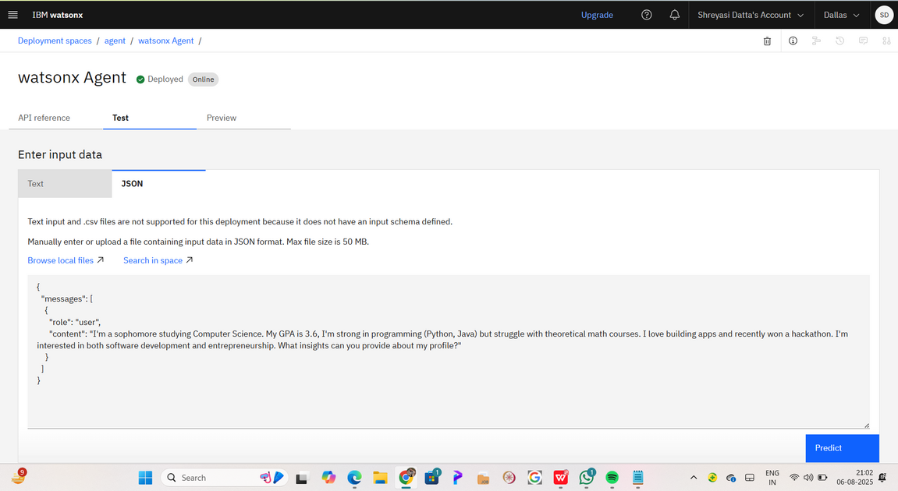
RESULTS - Deployed AI Agent

Slide 13


CONCLUSION
Personalized Guidance: The agent provides tailored career advice based on individual student profiles and real-time market data
Scalable Solution: Can serve unlimited students simultaneously, breaking traditional counseling limitations
Data-Driven Decisions: Uses comprehensive analytics to ensure career recommendations are backed by market realities
Continuous Learning: The agent improves its recommendations through ongoing interaction and feedback
Accessibility: Available 24/7, making career guidance accessible to all students regardless of location or time constraints
Future-Ready: Prepares students for evolving job markets by identifying emerging career opportunities

Slide 14

FUTURE SCOPE
Advanced Psychometric Testing: Integration of comprehensive personality assessments
Virtual Reality Career Exploration: Immersive experiences of different professional environments
Blockchain Credentials: Secure verification of skills and achievements
Global Mobility Guidance: International career opportunities and visa guidance
Entrepreneurship Pathway: Specialized guidance for students interested in starting businesses
Alumni Network Integration: Connecting students with successful alumni in their fields of interest
Parent Dashboard: Comprehensive view for parents to track their child's career development
Corporate Partnership Portal: Direct connections with companies for internships and job placements

Slide 15
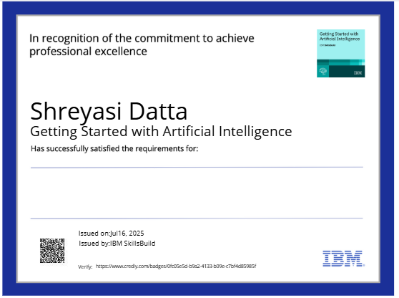
IBM Certifications

Slide 16
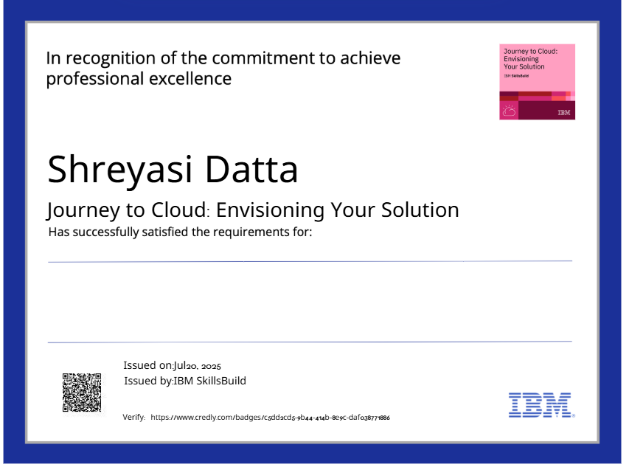
IBM Certifications

Slide 17
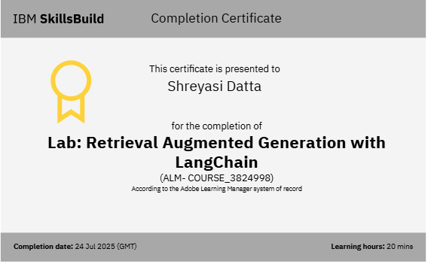
IBM Certifications :- RAG LAB certificate

Slide 18
github link : https://github.com/ShreyasiDatta/Agentic-Career-Counseling-Companion

Slide 19

Thank you very much!

